Slide 1
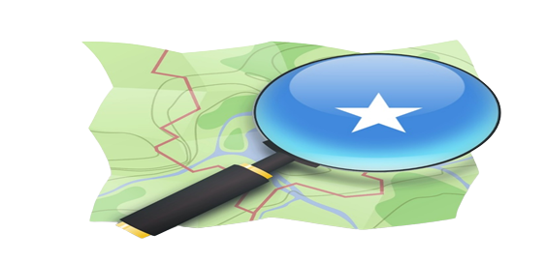
Mapping in a Fragile context
Ahmed Abdullahi, Abdullahi Kelly, OSMSomalia

Slide 2
About Us
OpenStreetMap Somalia is a Non-profit Organization established in 2017 that conducts digital and free mapping activities. We have been carrying out voluntary activities to promote OpenStreetMap to local authorities , NGOs, international organizations, and academics.

Slide 3
Our goal
To enable local communities, NGOs, international organizations, and government partners to use and contribute to OpenStreetMap for locally-relevant challenges through provision of training, equipment, knowledge exchange, and field projects.

Slide 4
Our Objective
To build a Comprehensive and accessible database of maps by creating an Open Spatial Data Infrastructure for Somalia.
To map the most vulnerable places in Somalia, in order that international and local NGOs and individuals can use the maps and data to better respond to crises affecting the areas.
To facilitate the communication and the coordination between people working on Humanitarian mapping with in Somalia.

Slide 5
1) Training and capacity building 2) Data collection and mapping 3) Data analysis and map production
What we do

Slide 6
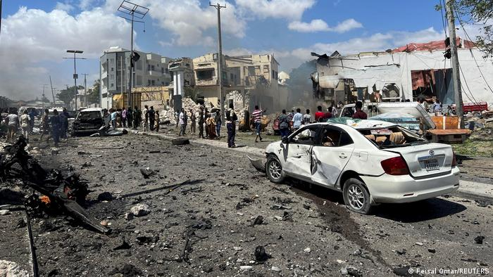
WHAT IS A FRAGILE CONTEXT
UNICEF defines fragile contexts as: contexts where there is an accumulation and combination of risks as a result of context-specific underlying causes combined with insufficient coping capacity of the state, system and/or communities to manage, absorb or mitigate those risks
Fragile contexts are the world’s most dangerous places. They are countries, cities, regions and communities that are fraught with chronic instability, conflict and violence, trapping large numbers of people in a cycle of desperation and poverty

Slide 7
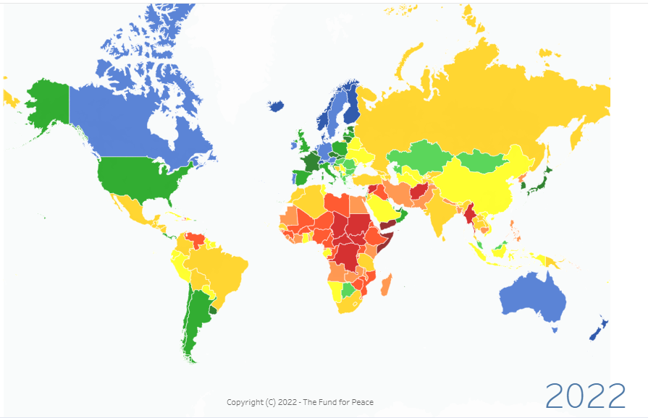
Fragility index 110.5 2nd after Yemen

Slide 8
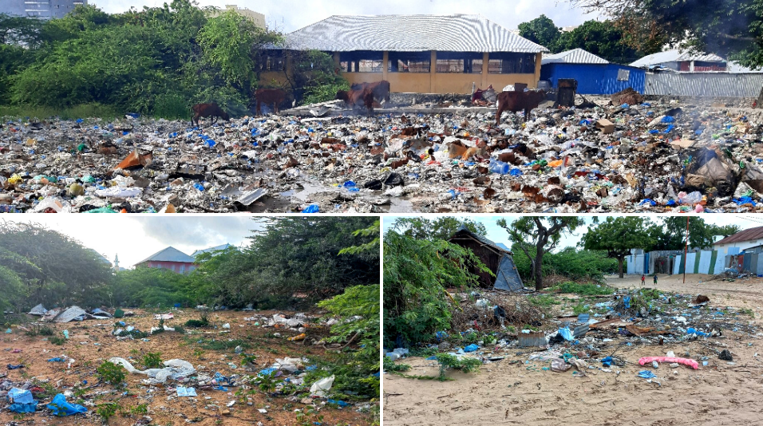
Solid waste Mapping project

Slide 9
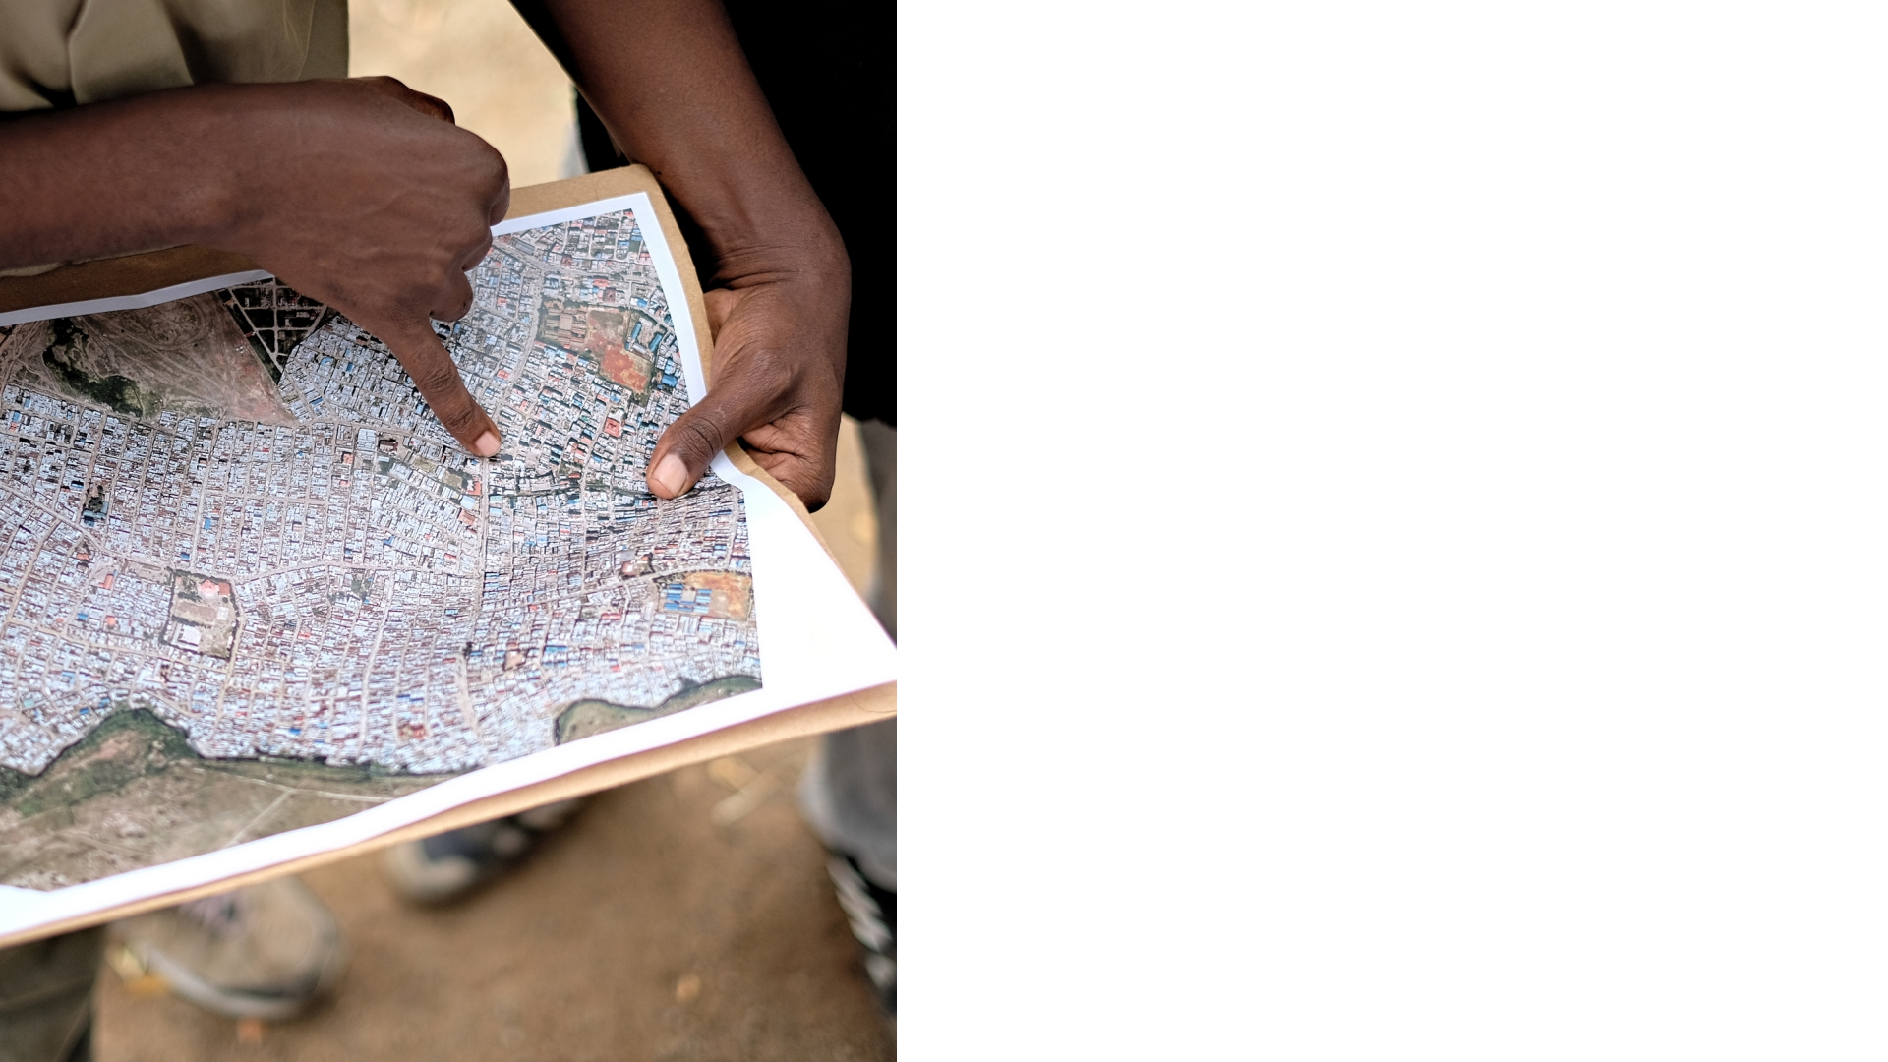
PROJECT OBJECTIVES
OBJECTIVE 1:
CREATE HIGH-QUALITY GEOGRAPHIC DATA THAT WILL BE USED TO UNDERSTAND THE VOLUME AND DISTRIBUTION OF SOLID WASTE SITES
OBJECTIVE 2:
CREATE EMPLOYMENT OPPORTUNITIES FOR SOMALIA’S YOUTH BY ENGAGING THEM TO COLLECT DATA
OBJECTIVE 3:
PROVIDE LEARNING OPPORTUNITIES ON VALUABLE DIGITAL SKILLS AND GEOSPATIAL TECHNOLOGY

Slide 10
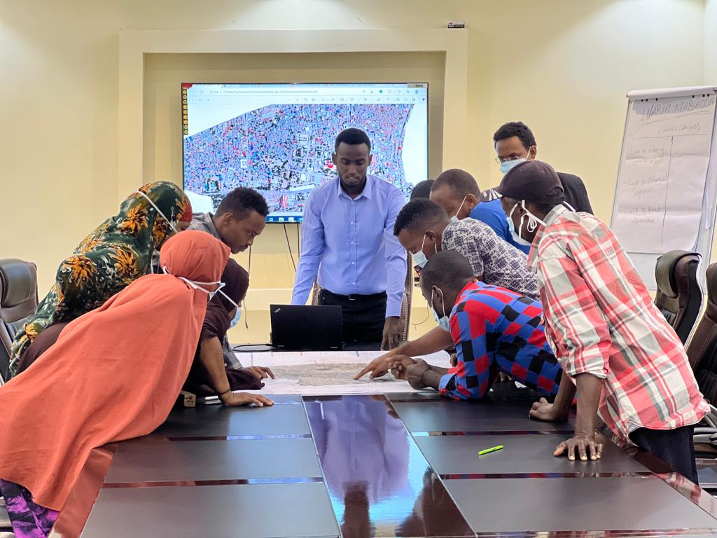
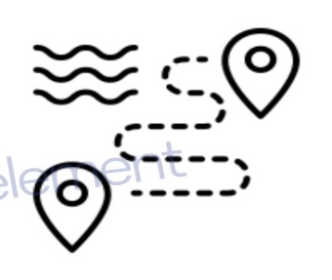
Approach
INCEPTION REPORT &
REMOTE MAPPING
DATA MODEL
CONSULTATIONS &
CREATION
TRAININGS, FGDS &
FIELD MAPPING FOR
17 DISTRICTS
DATA CLEANING,
UPLOAD TO OSM &
MAP CREATION

Slide 11
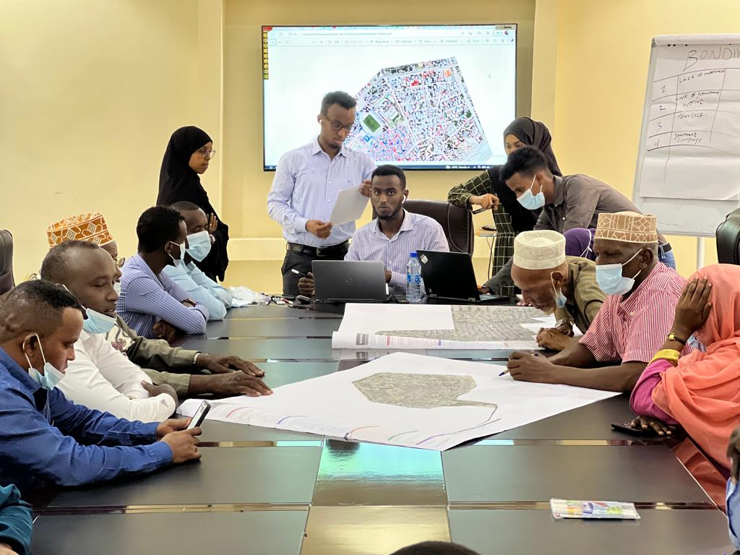
DATA MODEL
CONSULTATIONS &
CREATION

Slide 12
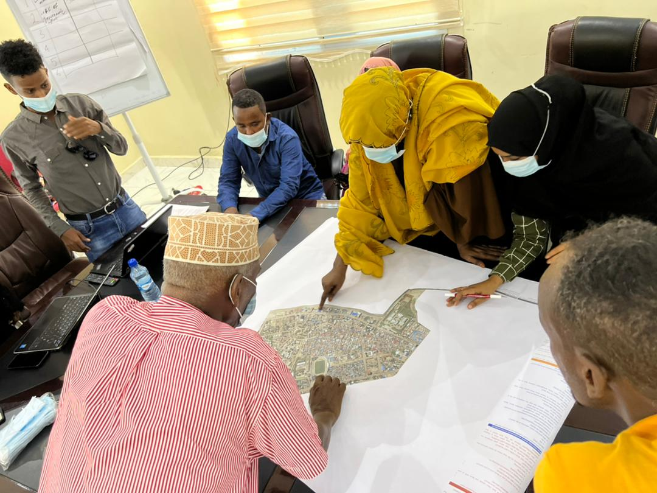
TRAININGS, FGDS &
FIELD MAPPING FOR
17 DISTRICTS

Slide 13
FGD methodology, was used to:
➢ To gather opinions and information of the broader community and others affected
by or working in solid waste management in Mogadishu.
➢ To find out the perceptions and attitudes toward the solid waste problem in the
areas.
➢ To identify the challenges that drive current waste management behavior.
➢ To find out the perceptions and attitudes toward the enforcement systems.
➢ To gather locations of main areas of focus as depicted by the participants which in
turn will inform the field data collection

Slide 14
Planning Field Data Collection
Step 1: Selection of data collectors
Step 2: Training of data collectors
Step 3: Data collection

Slide 15
Step 1: Selection of data collectors
The data collectors and FGD participants have been
Selected from the districts in which the fieldwork was happening.
Very familiar with the district.
Community leaders known in the community and youth leaders,
The number of data collectors was determined based on the size of the district and the amount of work (data to be collected).

Slide 16
Step 2: Training of data collectors
The training itself had three parts:
Review of the data collected during FGDs.
Getting familiar with the ODK.
Planning the mapping process.

Slide 17
Step 3: Data collection
The data collectors used the list of sites to be visited prepared during the training to carry out the data collection. The field activities were organized and strategic. The activities were organized in a way to minimize aimless wandering around the city.
The data collectors used to check the list of locations to be visited.
Plan their routes well using gridded maps
Organize escort.

Slide 18
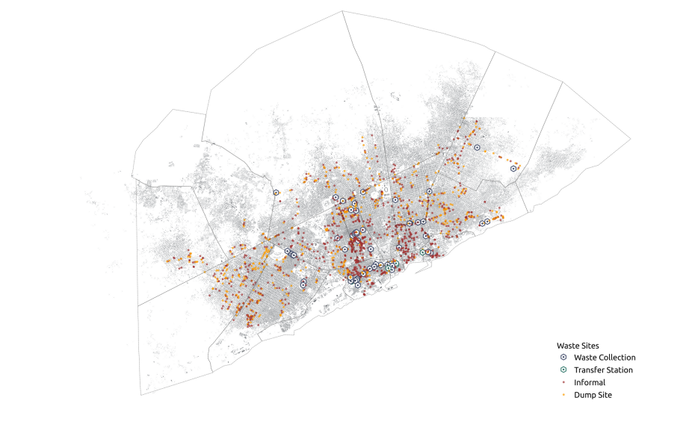
DATA CLEANING,
UPLOAD TO OSM &
MAP CREATION

Slide 19
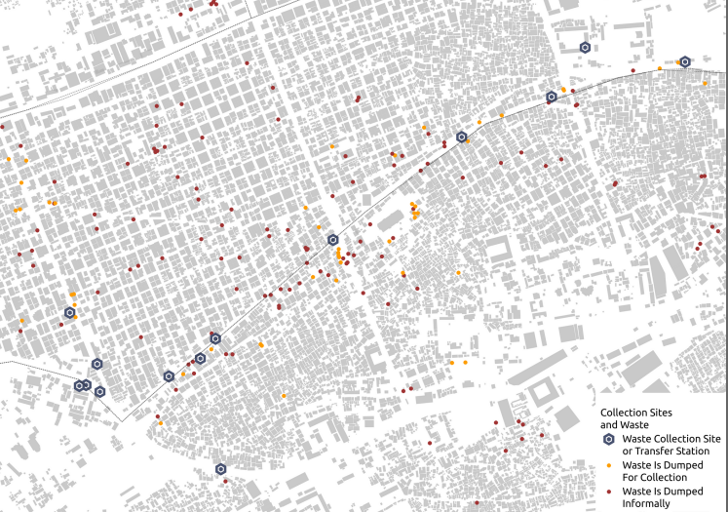

Slide 20
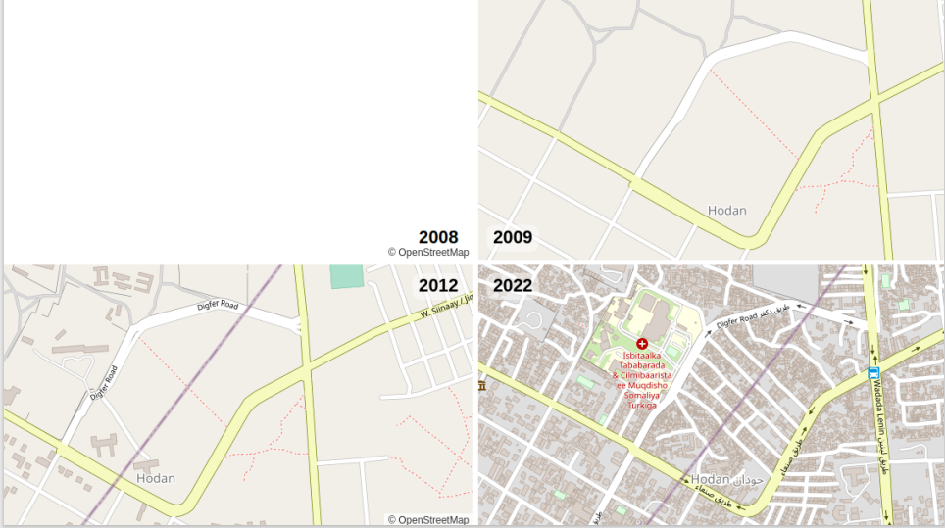

Slide 21
Challenges
Security issues
Cannot fly drones. Often, cannot take pictures
Security concerns with civilians
Security policies
2) Lack of update district boundaries
3) Lack of political will from the district authorities

Slide 22
THANK YOU

